Slide 1
Heuristic Search(2)
하 진 영
강원대학교 컴퓨터공학과

Slide 2
Admissibility, Monotonicity, and Informedness
Evaluation of the behavior along a number of dimensions:
  may require to find the shortest path
    could be important when an application might have an excessive cost for extra solution steps
    Heuristics that find the shortest path to a goal whenever it exists → admissibility
  may want to ask whether any better heuristics are available → informedness
  guarantee that the same state won’t be found later in the search at a cheaper cost → monotonicity

Slide 3
Admissibility Measures
Definition: Algorithm A, Admissibility
  consider the evaluation function f(n) = g(n) + h(n) where
    n is any state encountered in the search.
    g(n) is the cost of n from the start state.
    h(n) is the heuristic estimate of the cost of going from n to a goal
  If this evaluation function is used with the best_first_search algorithm, the result is called algorithm A.
  A search algorithm is admissible if, for any graph, it always terminates in the optimal solution path whenever a path from the start to a goal state exists.

Slide 4
Admissibility Measures (2)
Determining the properties of admissible heuristics
  useful to define an evaluation function f*:
  f*(n) = g*(n) + h*(n) where
    g*(n) is the cost of the shortest path from the start node to node n
    h* returns the actual cost of the shortest path from n to the goal
  ⇒ f*(n) is the actual cost of the optimal path from a start node to a goal node that passes through node n
If we employ best_first_search with the evaluation function f*, the resulting search strategy is admissible

Slide 5
Admissibility Measures (3)
Definition: Algorithm A*
  If algorithm A is used with an evaluation in which h(n) is less than or equal to the cost of the minimal path from n to the goal, the resulting search algorithm is called A*
  It is now possible to state a property of A* algorithm
    All A* algorithms are admissible

Slide 6
Admissibility Measures (4)
Any A* algorithm is guaranteed to find the minimal path from n to the goal, if such a path exists
  h(n) ≤ h*(n) for all n
    breadth-first search: f(n) = g(n) + 0
  the set of nodes considered by an A* algorithm is a subset of the states examined in breadth-first search
Heuristics providing A* algorithms for 8-puzzle
  counting number of tiles not in the goal position
  sum of the direct distances out of place
  using small multipliers for direct tile reversals

Slide 7
Monotonicity
The definition of A* algorithm did not require that g(n) = g*(n)
  admissible heuristics may initially reach nongoal states along a suboptimal path, as long as the algorithm eventually finds an optimal path to all states on the path to a goal
  natural to ask if
    there are heuristics that are “locally admissible”, i.e., that consistently find the minimal path to each state they encounter in the search → called monotonicity

Slide 8
Monotonicity (2)
Definition: Monotonicity
  A heuristic function h is monotone if
    1. For all states n_{i} and n_{j}, where n_{j} is a descendant of n_{i},
      h(n_{i}) − h(n_{j}) ≤ cost(n_{i}, n_{j}),
      where cost(n_{i}, n_{j}) is the actual cost (in number of moves) of going from state n_{i} to n_{j}.
    2. The heuristic evaluation of the goal state is zero, or h(Goal) = 0.
  When using a monotonic heuristic
    for best-first search, it is not necessary to check whether the new path is shorter
    f is monotonically nondecreasing
    any monotonic heuristic is admissible

Slide 9
Monotonicity (3)
For the sequence of moves in the arbitrary selected path:
  s₁ to s₂ h(s₁) − h(s₂) ≤ cost(s₁, s₂) by monotone property
  s₂ to s₃ h(s₂) − h(s₃) ≤ cost(s₂, s₃) by monotone property
  s₃ to s₄ h(s₃) − h(s₄) ≤ cost(s₃, s₄) by monotone property
  : : : : :
  s_{g−1} to s_{g} h(s_{g−1}) − h(s_{g}) ≤ cost(s_{g−1}, s_{g}) by monotone property
  summing each column and using the monotone property of h(s_{g}) = 0:
  path s₁ to s_{g} h(s₁) ≤ cost(s₁, s_{g})
  → this means that monotone heuristic h is A* and admissible

Slide 10
More Informed Heuristics
Definition: Informedness
  For two A* heuristics h₁ and h₂, if h₁(n) ≤ h₂(n), for all states n in the search space, heuristic h₂ is said to be more informed than h₁.
8-puzzle example
  heuristics
    h₁ : breadth-first search heuristic (h₁(x) = 0 for all states x)
    h₂: the number of tiles out of place
    h₃: the sum of the direct distances
  h₁(n) ≤ h₂(n) ≤ h₃(n) ≤ h*
The more informed an A* algorithm
  the less of the space it needs to expand to get the optimal solution

Slide 11
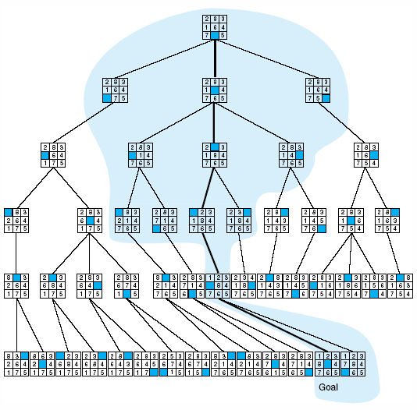
Fig 4.18 Comparison of state space searched using heuristic search with space searched by breadth-first search. The proportion of the graph searched heuristically is shaded. The optimal search selection is in bold. Heuristic used is f(n) = g(n) + h(n) where h(n) is tiles out of place.

Slide 12
More Informed Heuristics (2)
Trade-off of more informed heuristics
  simple heuristic
    requires less computation time
    relies on the speed of the computer to search as deeply as possible into the search space
  more informed heuristic
    requires more computation time
    may have exponential complexity
  extremely important to optimize this trade-off between search and evaluation of heuristics

Slide 13
Using Heuristics in Games
The Minimax Procedure on Exhaustively Searchable Graphs
Minimaxing to Fixed Ply Depth
The Alpha-Beta Procedure

Slide 14
The Minimax Procedure on Exhaustively Searchable Graphs
Two-person games
  more complicated than simple puzzle
    because of the existence of a “hostile” and essentially unpredictable opponent
    interesting as well as great difficulties in developing search algorithm
First we consider games whose state space is small enough to be exhaustively searched to find winning states

Slide 15
Example Game: Nim
Nim
  a number of matches are placed on a table between the two opponents
  at each move, the player must divide a pile of matches into two nonempty piles with different numbers of matches in each pile
    6 matches may be divided into piles of 5 and 1 or 4 and 2, but not 3 and 3
  the first player who can no longer make a move loses the game

Slide 16
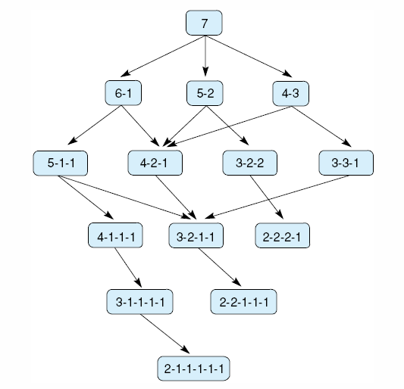
Fig 4.19 State space for a variant of nim. Each state partitions the seven matches into one or more piles.

Slide 17
MIN and MAX
MAX
  represents the player trying
    to win, or
    to MAXimize her advantage
MIN
  is the opponent who attempts to MINimize MAX’s score
Assumption
  MIN uses the same information and
  always attempts to move to a state that is worst for MAX

Slide 18
Implementation of MINIMAX
Label
  each level in the search space is labeled according to whose move it is at that point in the game, MIN or MAX
  each leaf node is given a value of 1 or 0
    1: a win for MAX
    0: a win for MIN
  minimax propagates these values up the graph through successive parent nodes according to:
    If the parent state is a MAX node, give it the maximum value among its children
    If the parent is a MIN node, give it the minimum value of its children

Slide 19
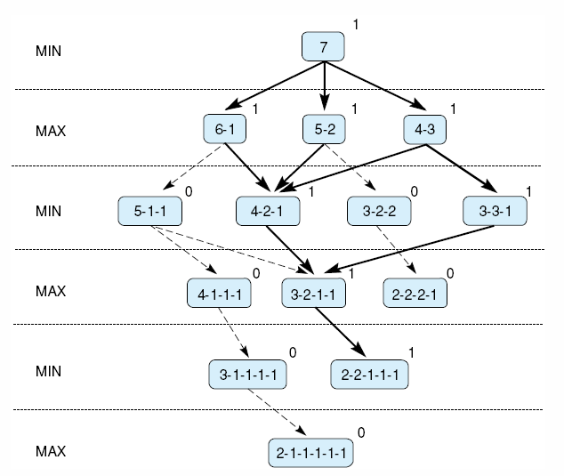
Fig 4.20 Exhaustive minimax for the game of nim. Bold lines indicate forced win for MAX. Each node is marked with its derived value (0 or 1) under minimax.
Who wins the game?

Slide 20
Minimaxing to Fixed Ply Depth
Most interesting case do not allow exhaustive search
  in applying minimax to more complicated games
    it is seldom possible to expand the state space graph out to the leaf nodes
    the state space is searched to a predefined number of levels, as determined by available time and memory
    n-move look-ahead
      n is the number of levels explored
    not possible to give values a win or a loss
      instead, heuristic evaluation value is given

Slide 21
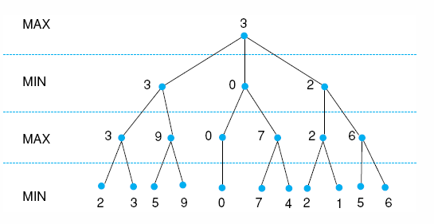
Minimaxing to Fixed Ply Depth (2)
Maximizing for MAX parents, and minimizing MIN parents, the values go back up the graph to the children of the current state
Fig 4.21 Minimax to a hypothetical state space. Leafstates show heuristic values; internal states show backed-up values.

Slide 22
MiniMax Procedure
Select the maximum worth alternative
Under assumption of that the opponent do her best
Back-Up Value (BUV)
  1. At tip node p, BUV is e(p)
  2. At MIN node, BUV is min of BUV of children
  3. At MAX node, BUV is max of BUV of children
  e(p): static evaluation function
    if p is win for MAX, then e(p) = ∞
    if p is win for MIN, then e(p) = −∞

Slide 23
MiniMax for Tic-Tac-Toe
Two player, X and O, X play first
Static evaluation function
  if p is not a winning position
  E(p) = (# of complete rows, columns, or diagonal that are still open for X) −
  (# of complete rows, columns, or diagonal that are still open for O)
  if p is a win for X, E(p) = ∞
  if p is a win for O, E(p) = −∞
Zero-sum game !

Slide 24
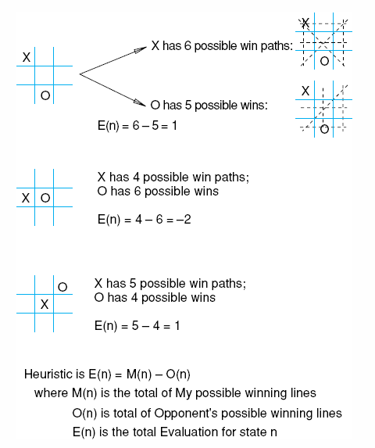
Fig 4.22 Heuristic measuring conflict applied to states of tic-tac-toe.

Slide 25
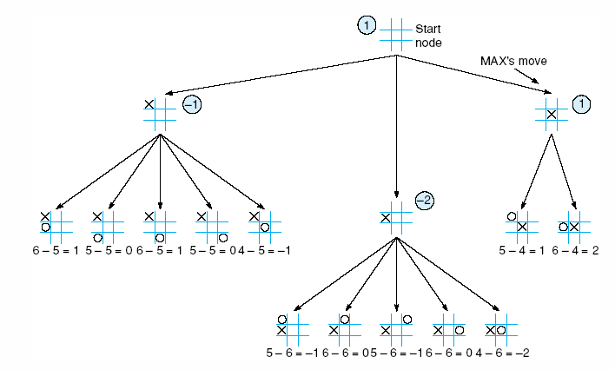
Fig 4.23 Two-ply minimax applied to the opening move of tic-tac-toe, from Nilsson (1971).

Slide 26
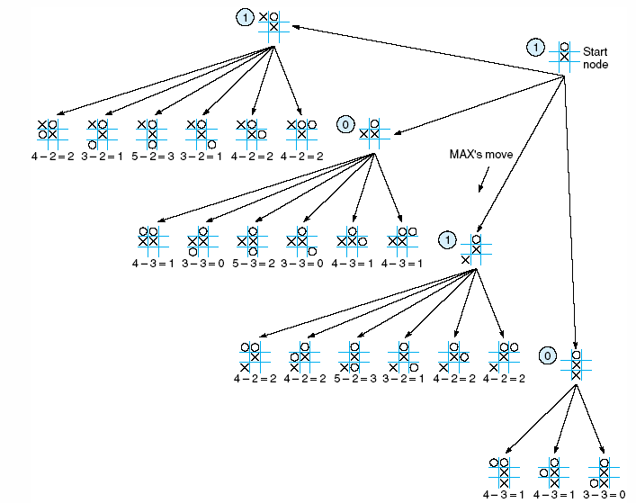
Fig 4.24 Two ply minimax, and one of two possible MAX second moves, from Nilsson (1971).

Slide 27
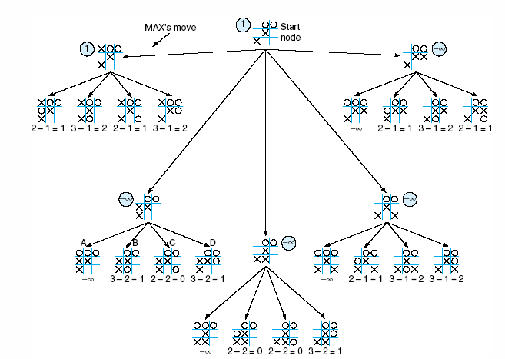
Fig 4.25 Two-ply minimax applied to X’s move near the end of the game, from Nilsson (1971).

Slide 28
Alpha-Beta Procedure
Straight MiniMax
  require a two-pass analysis of the search space
    the first to descend to the ply depth and there apply the heuristic and
    the second to propagate values back up the tree
Improvement of MiniMax procedure
  combining search procedure & evaluation
  search proceeds in a depth-first fashion
    two values, alpha and beta, are create during the search
      alpha-value of MAX never decrease
      beta-value of MIN never increase

Slide 29
Alpha-Beta Procedure (2)
Two rules for terminating search
  1. Search can be stopped below any MIN node having a beta value less than or equal to the alpha value of any of its MAX ancestors.
  2. Search can be stopped below any MAX node having an alpha value greater than or equal to the beta value of any of its MIN node ancestors.

Slide 30
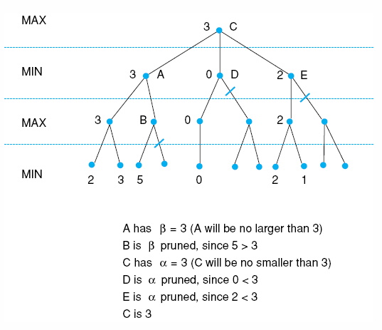
Fig 4.26 Alpha-beta pruning applied to state space of Fig 4.21. States without numbers are not evaluated.

Slide 31
Complexity Issues
Branching factor
  defined as the average number of descendants that emerge from any state in the space
  T = B + B² + B³ +…+B^{L} = B(B^{L} − 1) / (B − 1)
    B: branching factor
    L: path length
    T: total states in the search
Size of open and closed lists
Informedness

Slide 32
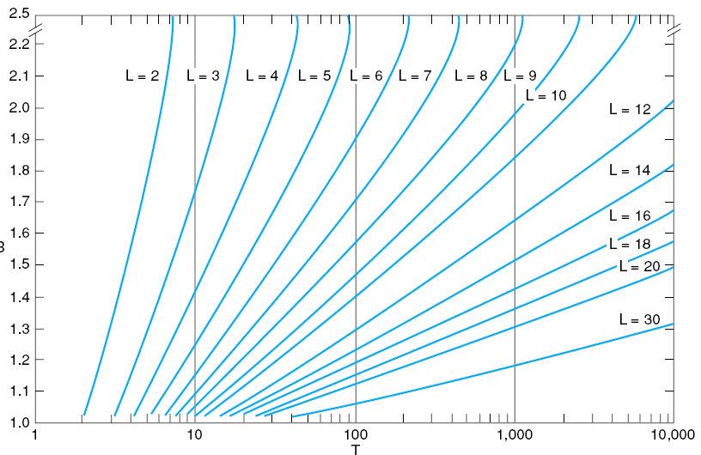
Fig 4.27 Number of nodes generated as a function of branching factor, B, for various lengths, L, of solution paths. The relating equation is T = B(B^{L} – 1)/(B – 1), adapted from Nilsson (1980).

Slide 33
Complexity Issues (2)
Size of open and closed lists
  method of keeping the size of open reasonable : to save on open only a few of the best states
    better focused search
    danger of possibly eliminating the best, even the only solution path
  beam search
    technique of maintaining a size bound
Informedness
  the more informed the search, the less the space must be searched
  computational costs of additional information needed

Slide 34
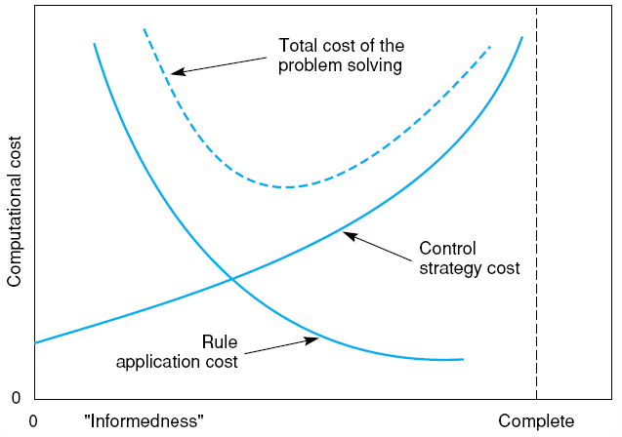
Fig 4.28 Informal plot of cost of searching and cost of computing heuristic evaluation against informedness of heuristic, adapted from Nilsson (1980).

